Slide 1
Cannabis strains
Fauzy caesarrochim

Slide 2
introduction
Cannabis, also known as marijuana among other names,[n 1] is a psychoactive drug from the Cannabis plant intended for medical or recreational use. The main psychoactive part of cannabis is tetrahydrocannabinol (THC); one of 483 known compounds in the plant, including at least 65 other cannabinoids. Cannabis can be used by smoking, vaporizing, within food, or as an extract.
Cannabis is often used for its mental and physical effects, such as a "high" or "stoned" feeling, a general change in perception, euphoria (heightened mood), and an increase in appetite. Onset of effects is within minutes when smoked, and about 30 to 60 minutes when cooked and eaten. They last for between two and six hours. Short-term side effects may include a decrease in short-term memory, dry mouth, impaired motor skills, red eyes, and feelings of paranoia or anxiety. Long-term side effects may include addiction, decreased mental ability in those who started as teenagers, and behavioral problems in children whose mothers used cannabis during pregnancy. Studies have found a strong relation between cannabis use and the risk of psychosis, though the cause-and-effect relationship is debated.

Slide 3
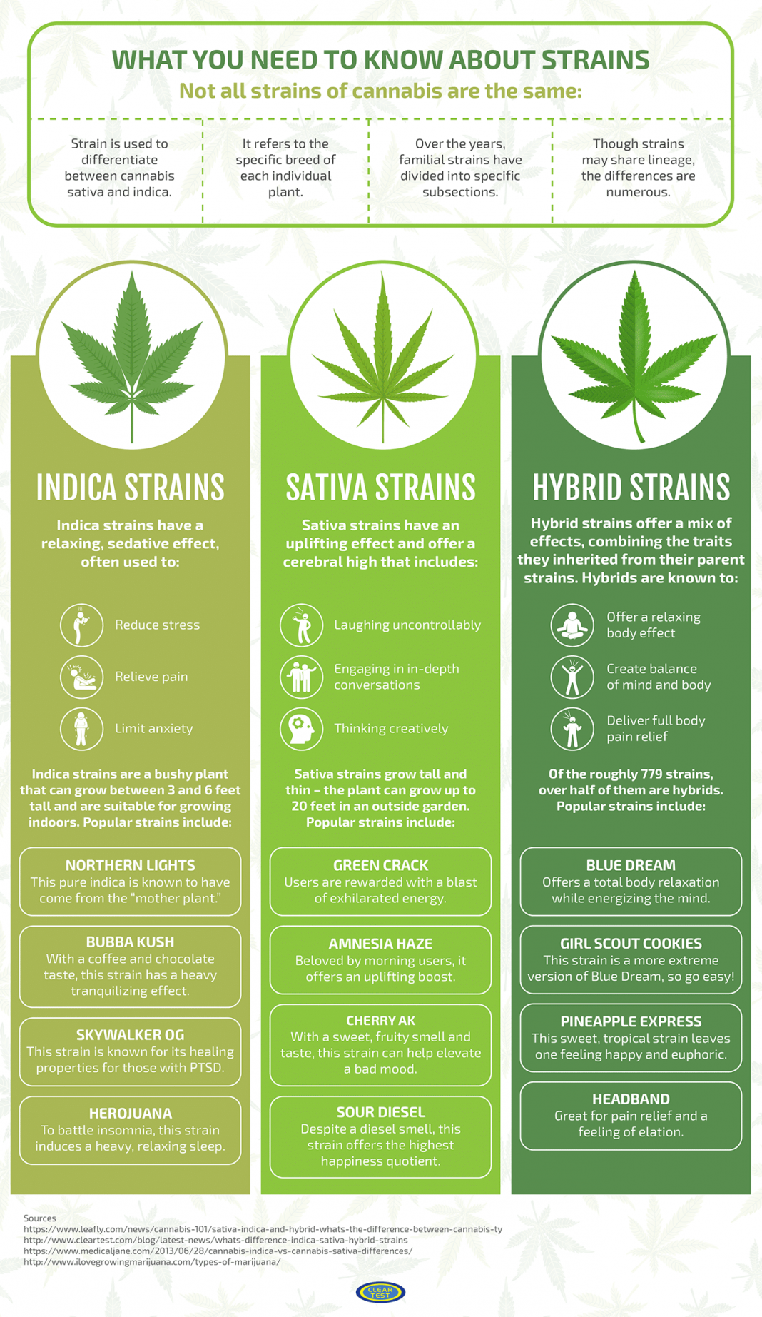

Slide 4
Why people using this cannabis strains?
Are the Species distribution of our dataset equal?
The all types of strains have the same rating distribution?
What the first word in description to each species?
Are the Flavor important to the rating ?
Are the Effect important to the rating?
Are some difference in Effects and Flavors related by specie?
Are the price affect to the Type Distribution?

Slide 5
Explanation
Lets take a look to Jupyter Notebook and VS Code to explain the detail

Slide 6
conclusion
Many People using this strains from hybrid type because they are cheap from among the others strains
The most Effects from this strains are Happy, Euphoric, Relaxed, Uplifted, and Energetic
The most Flavor from this strains are Earthy, Sweet, and Citrus
This model is good to predict hybrid type rather than the others types

Slide 7
source
https://www.kaggle.com/kabure/auto-ml-pipeline-predicting-cannabis-species
https://greendoctornetwork.com/strain-types-sativa-vs-indica-vs-hybrid/
https://marijuanally.com/whats-the-difference-between-sativa-vs-indica-cannabis
https://www.terravidahc.com/blog-1/2018/6/19/sativa-vs-indica-vs-hybrid-understanding-the-difference
https://my420tours.com/indica-vs-sativa/

